Slide 1
Semantics
The study of meaning

Slide 2
Contents
What is semantics?
What is meaning?
Meaning relations
-- relations between word meanings
-- relations between sentence meanings
Semantic roles

Slide 3
Definition of semantics
Semantics is generally defined as:
(1) Semantics is the study of meaning.
But…

Slide 4
Definition of semantics
Three categories of meaning:
a. meaning conveyed through human behaviour [human behaviour significance/meaning]
b. meaning conveyed through behaviour involving structured sets of conventional, commonly accepted symbols (language, traffic symbols, body language, etc.) [communicated meaning]
c. meaning conveyed through speaking / behaviour involving language [linguistic meaning]

Slide 5
Definition of semantics
Therefore, semantics is the study of linguistic meaning. Or we can say:
(2) Semantics is the study of meaning as expressed by the words, phrases and sentences of human languages.

Slide 6
Definition of semantics
But a sentence might convey different meanings by different speakers and in different contexts.
Semantics concerns the aspects of linguistic meaning that are independent of the use of language on any particular occasions by any particular individuals within any particular speech communities.

Slide 7
Definition of semantics
Therefore, a more accurate way to interpret semantics is that:
(3) Semantics is the study of those aspects of the meaning of linguistic expressions abstracted away from users, context and other cognitive and social factors.

Slide 8
What is meaning?
We often find ourselves talking about the meanings of words and sentences in daily life. For example,
-- “what is the meaning of ‘facebook’?”.
-- “Facebook is a social networking/media website”.
“It is ‘脸书’, something like Chinese ‘微信’”.
It seems that “meaning is more words”.
Can meanings be more words?

Slide 9
What is meaning?
How do scientists study linguistic meaning?
The meaning of an expression seems to be something abstract, obscure, and mysterious.
So scientists have been trying to identify meaning with something else, especially something relatively more familiar and observable.
Two identity theories of meaning:
the referential theory
the ideational theory

Slide 10
The referential theory
The meaning of an expression is its referent, the entity it refers to.
Taylor kissed John.
Taylor refers to a specific person named “Taylor’.
John refers to a specific person named “John”.
Kiss refers to a specific act --- “touch somebody with one’s lips”.

Slide 11
The referential theory
The referential theory has encountered some objections.
Your comments on this theory??

Slide 12
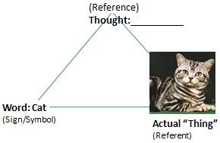
The ideational theory
The meaning of an expression is the idea/concept regularly associated with it.
The meaning of “cat” is the mental representation/imagery of the class of cats rather than the actual cats in the real world.

Slide 13
The ideational theory
The ideational theory has considerable charms.
First, resolving some of the challenges the previous theory encounters.
Second, consistent with the intuition that language is used to externalize one’s thoughts.

Slide 14

The ideational theory
The ideational theory has been facing some challenges.
Your comment on this theory??

Slide 15
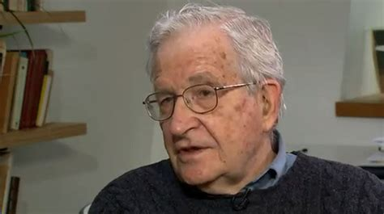
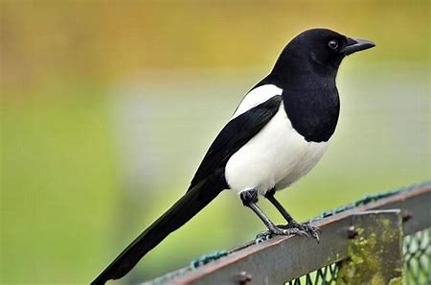
The ideational theory
Noam Chomsky is a linguist and philosopher.
I saw a magpie on that tree.

Slide 16
Meaning relations
Relations between word meanings
Relations between sentence meanings

Slide 17
Relations between word meanings
Synonymy
almost/nearly big/large broad/wide buy/purchase
cab/taxi car/automobile couch/sofa freedom/liberty answer/reply

Slide 18
Relations between word meanings
Antonymy
Complementary or contradictory antonyms
one member is true, the other member cannot be true.
-- male/female, married/unmarried, alive/dead, present/absent/ …
Relational antonyms
the existence of one of the terms implies the existence of the other term.
-- over/under, buy/sell, doctor/patient, teacher/pupil, stop/go, …
Gradable or scalar antonyms
referring to opposite ends of a continuum
hot/cold, big/small, tall/short, good/bad, strong/weak, beautiful/ugly, happy/sad, …

Slide 19
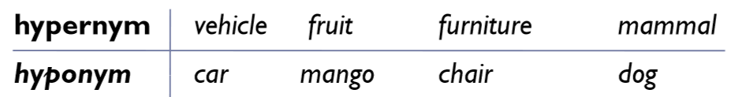
Relations between word meanings
Hyponymy
One sense is a hyponym of another sense if the first sense is more specific, denoting a subclass of the other.

Slide 20
Relations between word meanings
Homonymy
Homonyms are words with the same/similar spelling or/and pronunciation but with multiple unrelated senses.
John cashed a check at the bank.
Mary sat on the bank of the river and watched the currents.

Slide 21
Relations between word meanings
Polysemy occurs when a single linguistic form has two or more related senses.
Man: 1. human species, 2. males of human species, 3. adult males of human species
Date: 1. a fruit, 2 a particular day, 3. a romantic meeting, 4. the person you date, …

Slide 22
Relations between sentence meanings
Entailment
Given two sentences p and q, Whenever p is true, if q is also true then p entails q.
p: John loves Mary.
q: A man loves Mary.
p → q (p entails q)

Slide 23
Relations between sentence meanings
Entailments are typically not preserved under negation.
The 11th G20 summit was held in Hangzhou.
It entails:
The 11th G20 summit was held in China.
The 11th G20 summit was not held in Hangzhou.
It does not entail:
The 11th G20 summit was held in China.

